Slide 1
ANN for Concrete Strength prediction

Slide 2
Different Numbers of Layers and Nodes
Number of Layers: 1 - 6
Number of neurons : 1 - 64
Activation Function : hyperbolic tangent

Slide 3
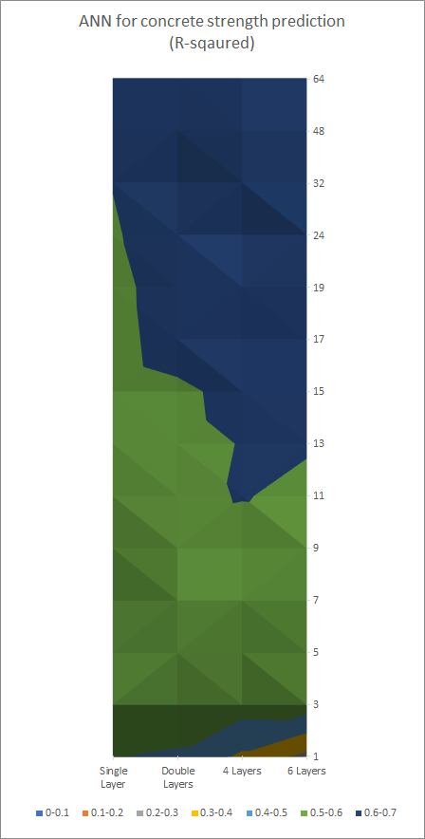
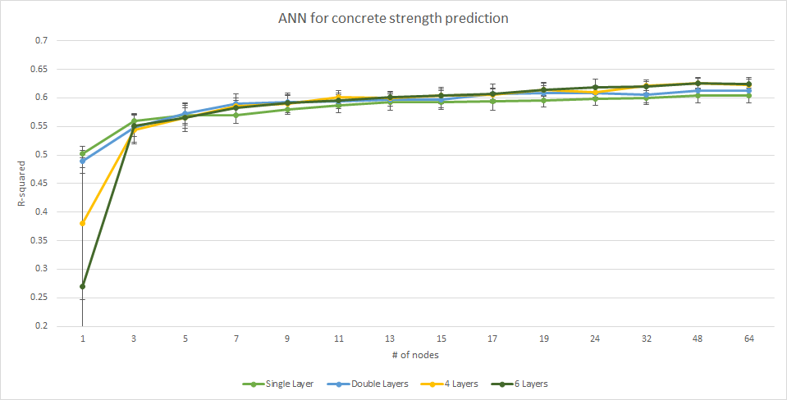
Different Number of Layers

Slide 4
Design strength prediction
 | R-Squared (std)
Design strength with raw data | 0.5797 (0.034)
Design strength with basic cleaned data | 0.9418 (0.0121)
28D with cleaned data | 0.6212 (0.0081)

